Slide 1

01 / THE IDEA
A little slower.
A little better.
A small neighborhood café for good
coffee, quiet moments, and the comfort of
becoming a regular. A focused concept for
potential business partners.
Slow Island Coffee
Launch proposal for potential business partners
Five slides · Five minutes
SLOW ISLAND COFFEE
THE IDEA / 01
Notes:
Spoken takeaway: “Slow Island is a neighborhood café designed to turn an everyday coffee stop into a familiar ritual.”
Speaker notes · 0:45 · 45 secondsIntroduce the calm, welcoming concept. Emphasize a focused operation and the potential to earn repeat visits; this is a proposal to validate, not a proven business.

Slide 2
02 / NEIGHBORHOOD CUSTOMERS
Different days.
One familiar place.
Our proposed customers live or work nearby. Everyday coffee habits and warm service
give Slow Island a reason to earn repeat visits.
01
02
03
Nearby residents
Local workers
Neighbors meeting
A morning coffee, a weekend pastry, or a
A reliable takeaway before work and a short
A casual catch-up or a quiet moment alone.
friendly stop on a walk. Familiar faces and
break at lunch. Clear ordering and quick
Comfortable seating and approachable
consistent quality can make us part of their
preparation matter as much as the atmosphere.
products create an easy reason to stay.
routine.
OCCASION: A USEFUL PAUSE
OCCASION: SIMPLE CONNECTION
OCCASION: EVERYDAY COMFORT
CUSTOMER HYPOTHESES / VALIDATE WITH INTERVIEWS + POP-UPS
WHO WE SERVE / 02
Notes:
Spoken takeaway: “Our strongest opportunity is to become a regular stop for people who live or work nearby.”
Speaker notes · 0:50 · 50 secondsWalk through residents, local workers, and neighbors meeting. Explain their different visit occasions, then note that interviews and paid pop-ups will test these customer hypotheses.

Slide 3
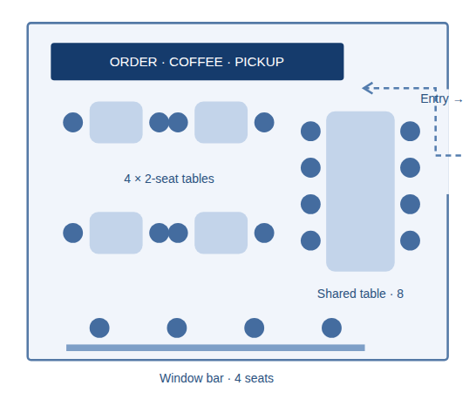
03 / PRODUCTS + SPACE
A focused menu.
A place to pause.
Coffee, tea, and a small bakery selection in a compact, proposed 20-
seat café.
01
Coffee
Dependable espresso drinks, batch brew, and one seasonal special.
02
Tea
Black tea, green tea, and a caffeine-free herbal infusion.
03
A small bakery selection
Croissants, seasonal loaf cake, and one rotating pastry from a local bakery.
A concise menu limits complexity and waste. Keep takeaway flow separate from seating; verify site access,
utilities, and permissions.
20 seats · concept sketch, not to scale
PROPOSED MENU + LAYOUT / VALIDATE LOCALLY
THE EXPERIENCE / 03
Notes:
Spoken takeaway: “A simple coffee, tea, and bakery offer makes a compact 20-seat café welcoming and manageable.”
Speaker notes · 1:10 · 70 secondsIntroduce the three product groups and explain why the menu stays small. Point out four two-seat tables, an eight-seat shared table, and four window seats. The sketch is not to scale; verify circulation, accessibility, and site suitability before a lease.

Slide 4
04 / FICTIONAL PLANNING BUDGET
A clear starting budget.
A shared basis for decisions.
TOTAL PLANNED LAUNCH FUNDS
ALLOCATION / YUAN
¥200,000
Equipment
¥60,000
· 30%
Four planning allocations.
Renovation
¥80,000
· 40%
Working capital represents 25% of the total.
Initial ingredients
¥10,000
· 5%
Fictional figures supplied for this proposal. These are planning allocations, not supplier quotes or a revenue
forecast.
Working capital
¥50,000
· 25%
0
40,000
80,000
Partner checkpoint:
confirm what each allocation covers and model rent, staffing, sales, and cash needs. Check deposits, permits, and contingencies for gaps before committing funds.
CURRENCY: YUAN / ALLOCATION ≠ PROFITABILITY
THE BUDGET / 04
Notes:
Spoken takeaway: “The fictional launch budget totals 200,000 yuan, including 50,000 yuan of working capital.”
Speaker notes · 1:05 · 65 secondsRead the four allocations: equipment 60,000; renovation 80,000; initial ingredients 10,000; working capital 50,000 yuan. The bars share a common scale. Confirm quotes and funding gaps before committing.

Slide 5
05 / NEXT STEPS FOR PARTNERS
Earn the routine.
Build the business together.
Worth exploring because the concept combines an everyday purchase, a welcoming
neighborhood role, and a focused operation. The next step is to test the case together.
01 / VALIDATE
02 / ALIGN
03 / COMMIT
Prove demand
Agree the partnership
Open in stages
Interview nearby residents and workers, count site footfall, and run
Define contributions, ownership, operating roles, and decision
Proceed only with a viable site, permissions, and a workable cash
paid pop-ups. Test menu prices and willingness to return.
rights. Obtain quotes and review the ¥200,000 allocation against
plan. Soft-open, then review orders, repeat visits, labor, and waste
cash needs.
weekly.
PROPOSED DECISION: BEGIN A FOUR-WEEK VALIDATION PHASE
PARTNER PROPOSAL / VALIDATE BEFORE MAJOR COMMITMENTS
LET’S BEGIN / 05
Notes:
Spoken takeaway: “The next partner decision is to validate demand and agree the partnership before making major commitments.”
Speaker notes · 1:10 · 70 secondsPropose a four-week validation phase. Assign demand testing, site research, and budget review. Agree contributions, ownership, and operating roles; proceed only when demand, site suitability, and cash needs support the case.

